Slide 1
Task 7: Set Up Monitoring and Logging (CloudWatch, ELK)

Slide 2
WHAT IS ELK?
In AWS, "ELK" stands for Elasticsearch, Logstash, and Kibana. It's a stack of open-source tools commonly used for searching, analyzing, and visualizing large amounts of log data in real-time.
Elasticsearch: A search and analytics engine used for indexing and querying data.
Logstash: A data processing pipeline that collects, processes, and forwards logs and other data.
Kibana: A data visualization dashboard for Elasticsearch, allowing users to interact with the data and create visual reports.

Slide 3
KEY FEATURES OF ELASTICSEARCH:
1.Real-time Search and Analytics:
Elasticsearch enables real-time search and data analysis. As data is ingested, it's indexed and immediately available for querying, which is crucial for use cases like log monitoring, application search, and more.
2. RESTful API:
Elasticsearch uses a RESTful API for interacting with the system, making it easy to integrate with various platforms and applications over HTTP.
3. Multi-Index Search:
Elasticsearch can manage and search across multiple indices simultaneously, which allows for a high degree of flexibility when organizing data.

Slide 4
KEY FEATURES OF LOGSTASH:
1.Real-Time Processing:
Logstash can process data in near real-time, meaning it can handle high volumes of data with low latency, which is ideal for log analysis and real-time event processing.
2. Support for Multiple Output Destinations:
Logstash can send processed data to multiple destinations at once, such as Elasticsearch, Kafka, Amazon S3, and more. This flexibility allows it to fit into various architectures.
3. Data Aggregation:
Logstash can be used for data aggregation and summarization before sending it to Elasticsearch or other destinations. This is useful when you need to consolidate or calculate metrics from logs.

Slide 5
KEY FEATURES OF KIBANA:
1.Data Visualization:
Bar charts, line charts, pie charts, heatmaps, maps (for geospatial data), and more.
2. Real-Time Dashboards:
Kibana enables you to create real-time interactive dashboards that update dynamically as new data arrives in Elasticsearch.
3. Search and Filtering:
You can use simple keyword searches or more complex Lucene or KQL (Kibana Query Language) queries to drill down into your data.

Slide 6
WHAT IS EC2 INSTANCE?
An EC2 instance (Elastic Compute Cloud instance) is a virtual server in Amazon Web Services (AWS) that you can use to run applications, host websites, or process data, similar to how a physical server would work but with more flexibility and scalability.
EC2 instances are the fundamental building blocks for running applications in AWS.

Slide 7
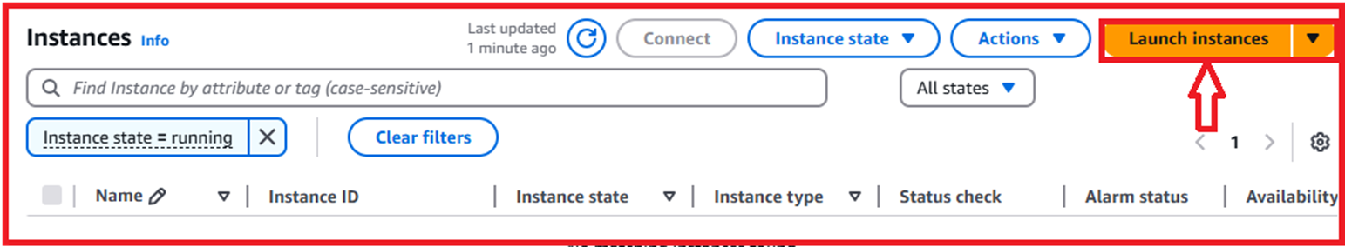
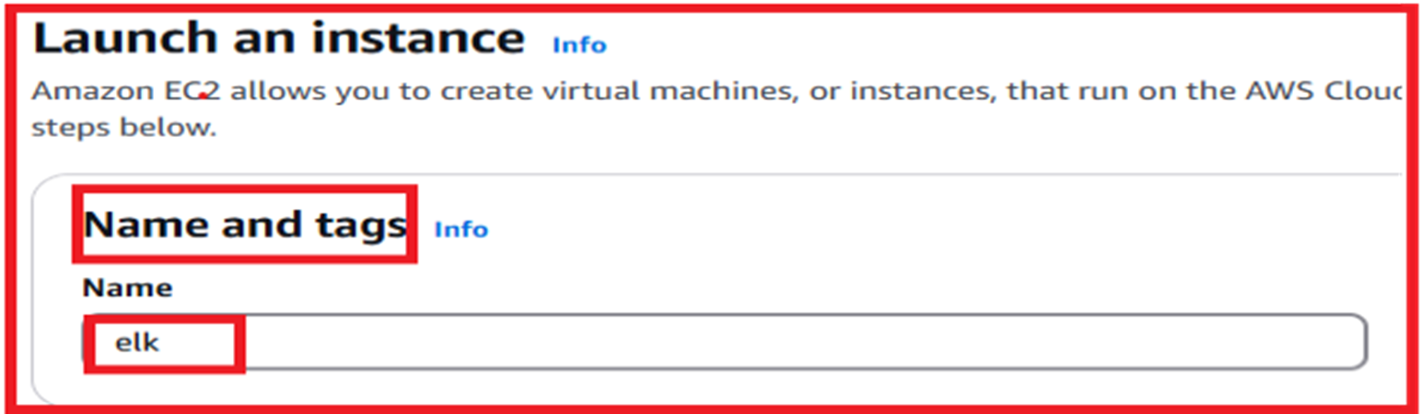
STEP 1:LAUNCH AN EC2 INSTANCE
Go to EC2 dashboard ,click on the launch instances and the following image is shown below.
Click on the Name and tags and give the name as elk and the following image is shown below.

Slide 8
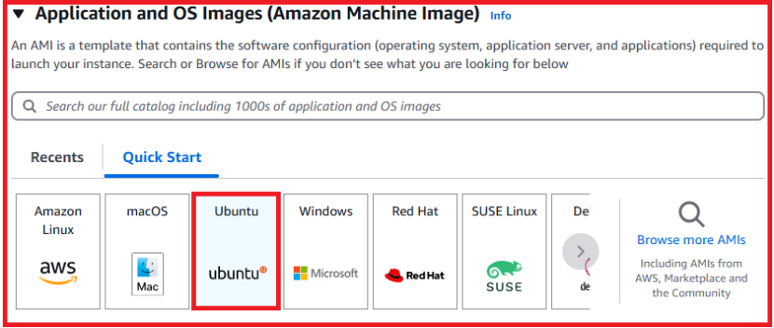
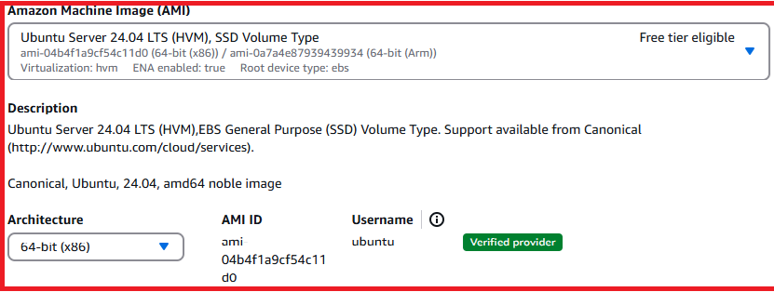
Click on the Application and OS images(Amazon Machine Image) and select the Ubuntu as the following images are shown below.

Slide 9
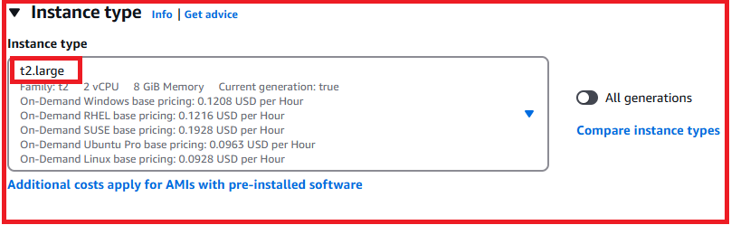
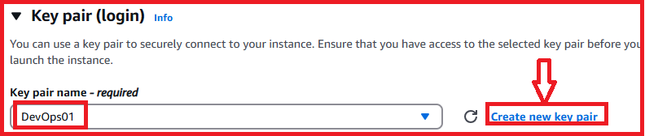
Click on the Instance type as t2.large and the following image is shown below.
Click on the Key pair (login) and give the key pair name as (DevOps01) or else create new key pair and the following image is shown below.

Slide 10
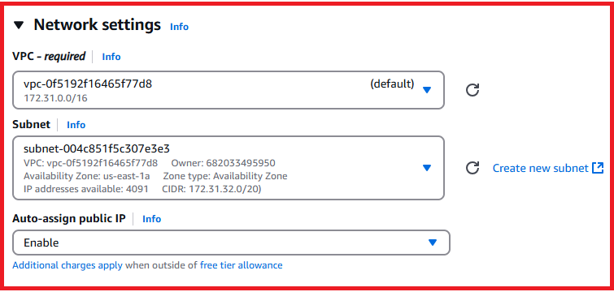
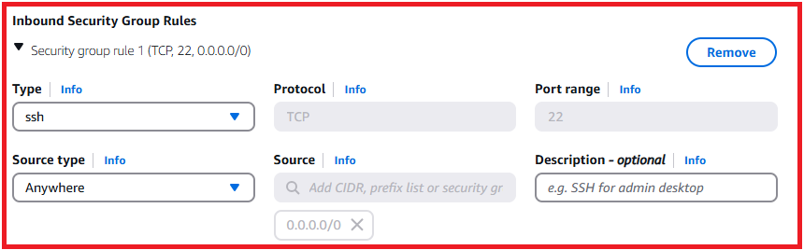
Click on the Network settings and select the default vpc,subnet,auto-assign public IP as enable and the following image is shown below.
Click on the Inbound Security Group Rules and give the type as ssh and source type as anywhere and the following image is shown below.

Slide 11
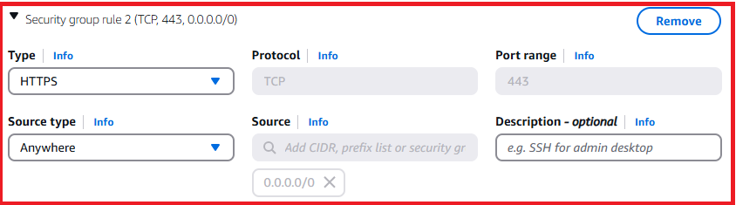
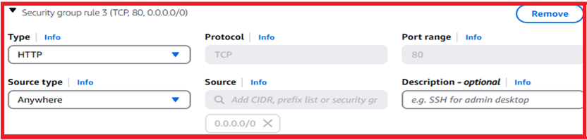
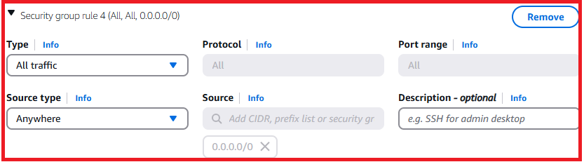
Inbound security group rule type as HTTPS,HTTP,ALL traffic and the source type as Anywhere and the following images are shown below.

Slide 12
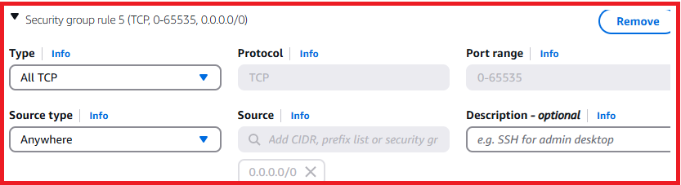
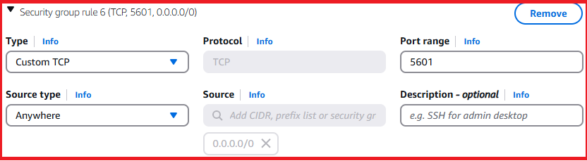
Inbound security group rule type as ALL TCP ,Custom TCP port range(5601) and he source type as Anywhere and the following images are shown below.

Slide 13
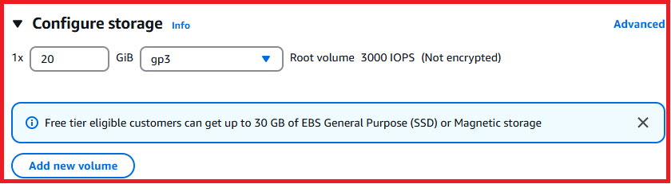
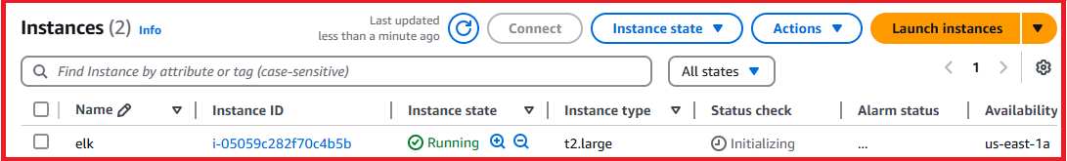
Click on the Configure storage as 20 GiB and the following image is shown below.
Click on the launch instances and the instance is successfully created and the following image is shown below.

Slide 14
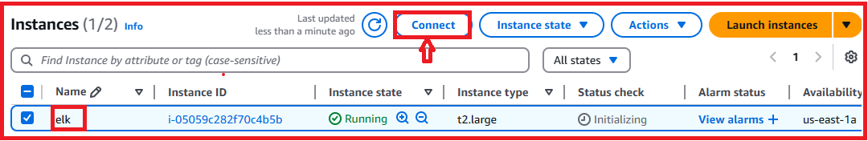


Click on the instance is running and connect the instance and the following images are shown below.

Slide 15
STEP 2:INSTALL ELK IN AN INSTANCE
1 sudo apt-get update
2 sudo apt-get install -y openjdk-8-jdk
3 sudo apt-get update
4 sudo apt-get -y install nginx
5 sudo wget https://artifacts.elastic.co/downloads/elasticsearch/elasticsearch-7.2.0-amd64.deb
6 sudo dpkg -i elasticsearch-7.2.0-amd64.deb
7 sudo wget https://artifacts.elastic.co/downloads/kibana/kibana-7.2.0-amd64.deb
8 sudo dpkg -i kibana-7.2.0-amd64.deb
9 sudo wget https://artifacts.elastic.co/downloads/logstash/logstash-7.2.0.deb
10 sudo dpkg -i logstash-7.2.0.deb

Slide 16
11 sudo wget https://artifacts.elastic.co/downloads/beats/filebeat/filebeat-7.2.0-amd64.deb
12 sudo dpkg -i filebeat-7.2.0-amd64.deb
13 sudo nano /etc/elasticsearch/elasticsearch.yml
14 sudo systemctl start elasticsearch
15 sudo systemctl enable elasticsearch
16 sudo systemctl status elasticsearch
17 sudo nano /etc/kibana/kibana.yml
18 sudo systemctl start kibana
19 sudo systemctl enable kibana
20 sudo systemctl status kibana
21 sudo apt-get install -y apache2-utils
22 sudo htpasswd -c /etc/nginx/htpasswd.users kibadmin
23 sudo nano /etc/nginx/sites-available/default
24 sudo ln -s /etc/nginx/sites-available/kibana /etc/nginx/sites-enabled/
25 sudo rm /etc/nginx/sites-enabled/default
26 sudo nginx -t

Slide 17
27 sudo nano /etc/nginx/sites-available/kibana
28 sudo ln -s /etc/nginx/sites-available/kibana /etc/nginx/sites-enabled/
29 ls -l /etc/nginx/sites-enabled/
30 sudo rm /etc/nginx/sites-enabled/kibana
31 sudo ln -s /etc/nginx/sites-available/kibana /etc/nginx/sites-enabled/
32 sudo nginx -t
33 sudo systemctl restart nginx
34 sudo systemctl status nginx
35 sudo systemctl start kibana
36 sudo systemctl status kibana
37 sudo nginx -t

Slide 18
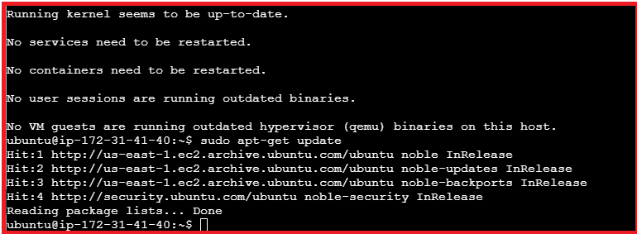
By giving the below commands
1. sudo apt-get update
2. sudo apt-get install -y openjdk-8-jdk
3. sudo apt-get update
The following image is shown below.

Slide 19
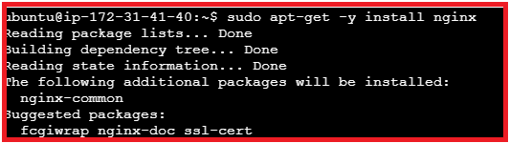
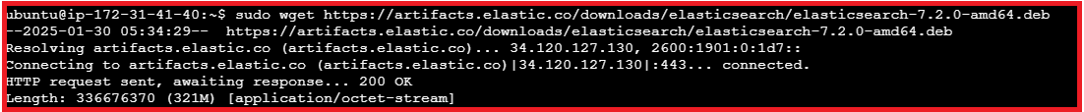
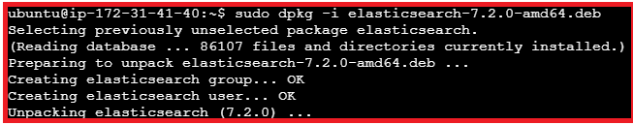
4 sudo apt-get -y install nginx
5 sudo wget https://artifacts.elastic.co/downloads/elasticsearch/elasticsearch-7.2.0-amd64.deb
6 sudo dpkg -i elasticsearch-7.2.0-amd64.deb
The following images are shown below.

Slide 20
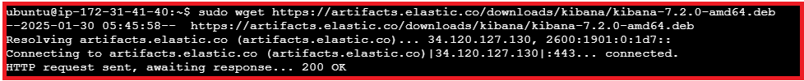

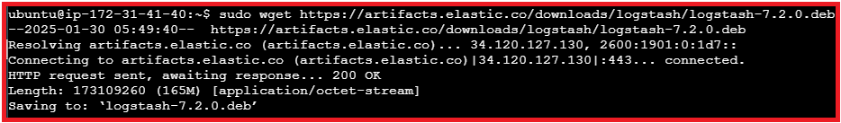
7 sudo wget https://artifacts.elastic.co/downloads/kibana/kibana-7.2.0-amd64.deb
8 sudo dpkg -i kibana-7.2.0-amd64.deb
9 sudo wget https://artifacts.elastic.co/downloads/logstash/logstash-7.2.0.deb
The following images are shown below.

Slide 21
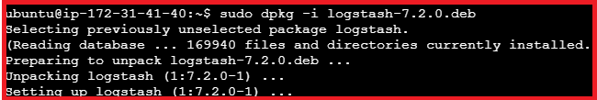
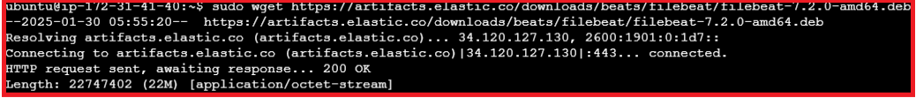
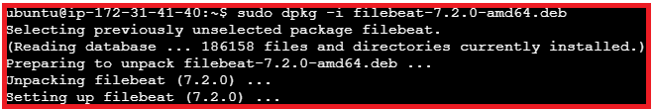
10 sudo dpkg -i logstash-7.2.0.deb
11 sudo wget https://artifacts.elastic.co/downloads/beats/filebeat/filebeat-7.2.0-amd64.deb
12 sudo dpkg -i filebeat-7.2.0-amd64.deb
The following images are shown below.

Slide 22
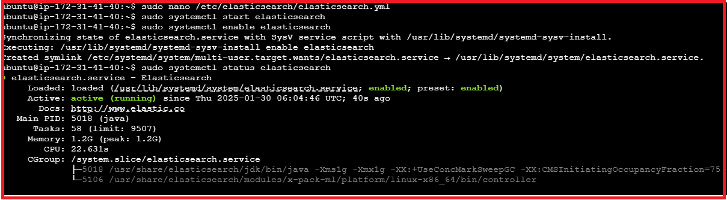
13 sudo nano /etc/elasticsearch/elasticsearch.yml
remove # for cluster.name: my-application
remove # for http.port: 9200
14 sudo systemctl start elasticsearch
15 sudo systemctl enable elasticsearch
16 sudo systemctl status elasticsearch
The following image is shown below.

Slide 23
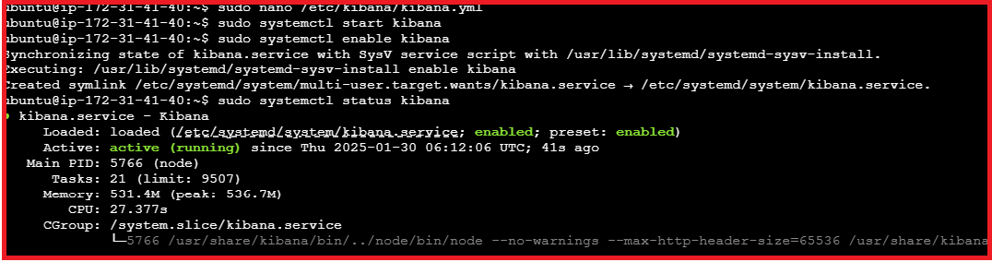
17 sudo nano /etc/kibana/kibana.yml
remove # for server.port: 5601
remove # for server.host: "localhost“
18 sudo systemctl start kibana
19 sudo systemctl enable kibana
20 sudo systemctl status kibana
The following image is shown below.

Slide 24
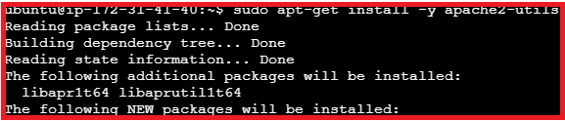

21 sudo apt-get install -y apache2-utils
22 sudo htpasswd -c /etc/nginx/htpasswd.users kibadmin
The following images are shown below.

Slide 25
23 sudo nano /etc/nginx/sites-available/default
server {
listen 80;
server_name your_domain_or_public_IP; # Replace with your domain or public IP
location / {
proxy_pass http://localhost:5601; # Kibana runs on port 5601 by default
proxy_http_version 1.1;
proxy_set_header Upgrade $http_upgrade;
proxy_set_header Connection 'upgrade';
proxy_set_header Host $host;
proxy_cache_bypass $http_upgrade;
}
}

Slide 26
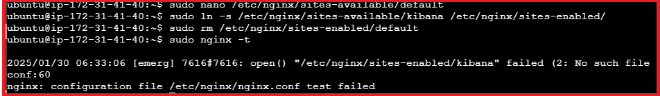
24 sudo ln -s /etc/nginx/sites-available/kibana /etc/nginx/sites-enabled/
25 sudo rm /etc/nginx/sites-enabled/default
26 sudo nginx -t
The following image is shown below.

Slide 27
27 sudo nano /etc/nginx/sites-available/kibana
server {
listen 80;
server_name 54.224.135.245; # Replace with your public IP address
auth_basic "Restricted Access";
auth_basic_user_file /etc/nginx/htpasswd.users;
location / {
proxy_pass http://localhost:5601;
proxy_http_version 1.1;
proxy_set_header Upgrade $http_upgrade;
proxy_set_header Connection "Upgrade";
proxy_set_header Host $host;
proxy_cache_bypass $http_upgrade;
}
}

Slide 28
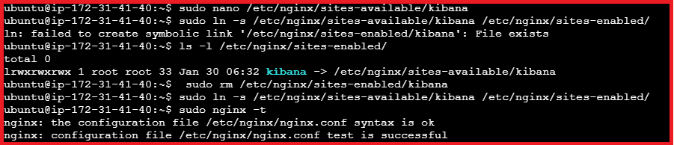
28 sudo ln -s /etc/nginx/sites-available/kibana /etc/nginx/sites-enabled/
29 ls -l /etc/nginx/sites-enabled/
30 sudo rm /etc/nginx/sites-enabled/kibana
31 sudo ln -s /etc/nginx/sites-available/kibana /etc/nginx/sites-enabled/
32 sudo nginx –t
The following image is shown below.

Slide 29
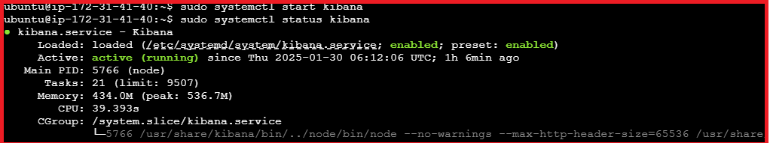

33 sudo systemctl restart nginx
34 sudo systemctl status nginx
35 sudo systemctl start kibana
36 sudo systemctl status kibana
37 sudo nginx –t
The following images are shown below.

Slide 30
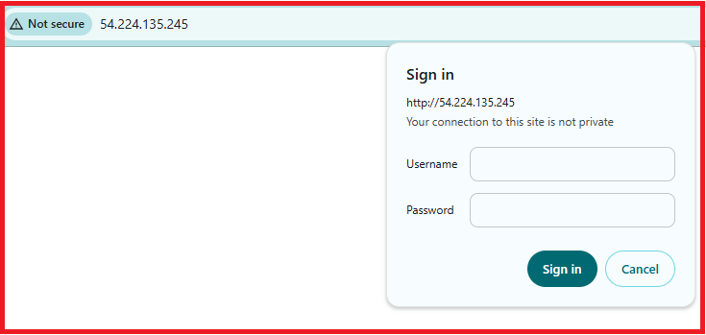
STEP 3:OPEN KIBANA DASHBOARD
Copy the public IP address of your instance and paste it on google new tab and the following image is shown below.
Sign in as username (kibadmin) and the password is created in an instance.

Slide 31
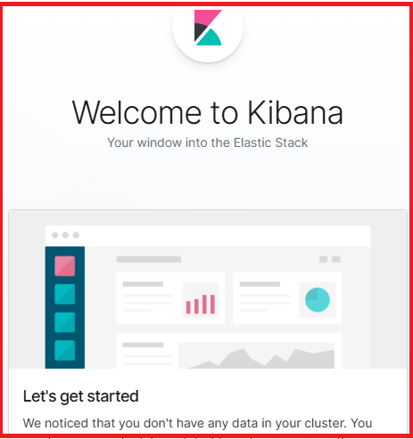
The Kibana dashboard is opened and the following image is shown below.

Slide 32
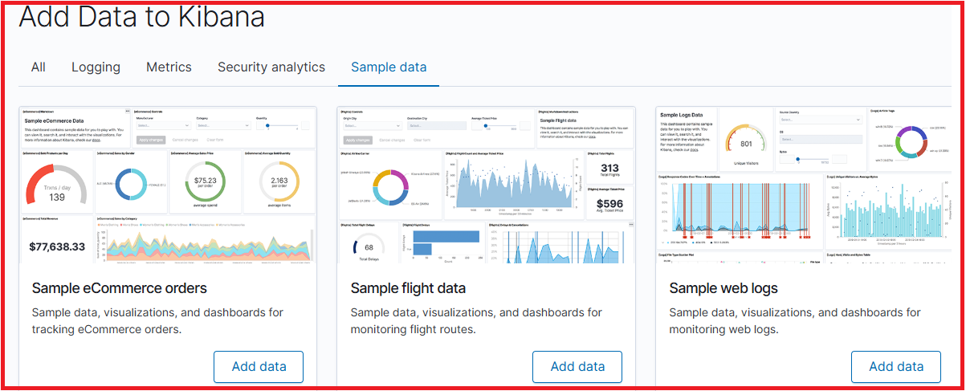
Click on the Try our sample data and add data to Kibana and click on the add data of sample ecommerce orders the following image is shown below.

Slide 33
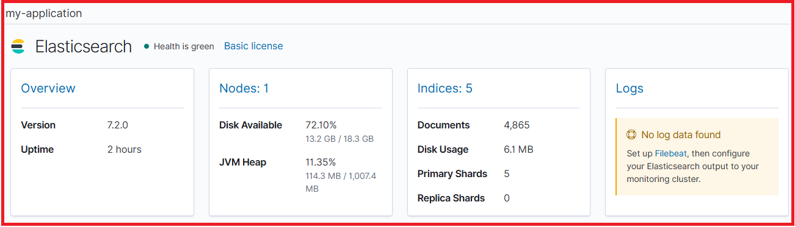
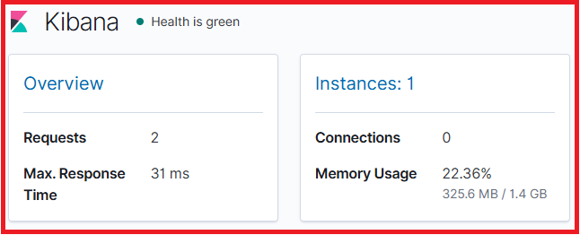
STEP 4:STACK MONITORING
Go to the stack monitoring in the left side bar of the Kibana dashboard and the following images are shown below.

Slide 34
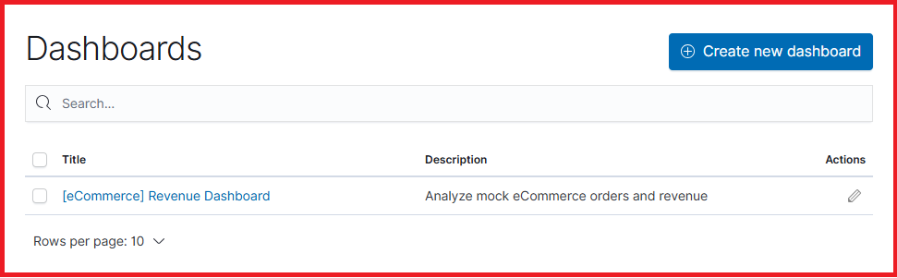
STEP 5:DASHBOARD IN KIBANA
Click on the dashboards in left side bar of the Kibana and the following image is shown below.

Slide 35
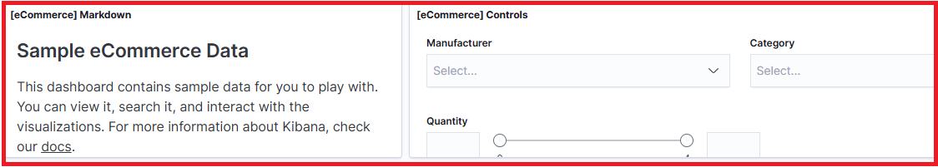
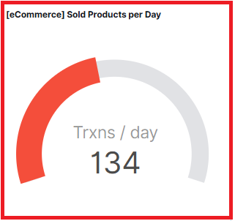
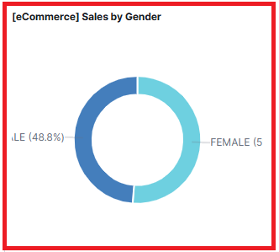
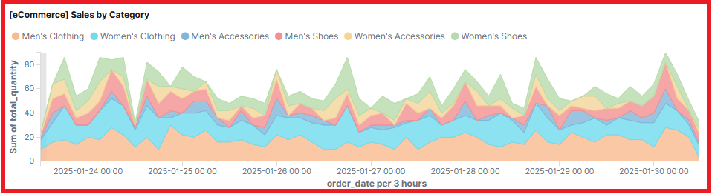
Click on the [ecommerce] revenue dashboard and the following images are shown below.

Slide 36
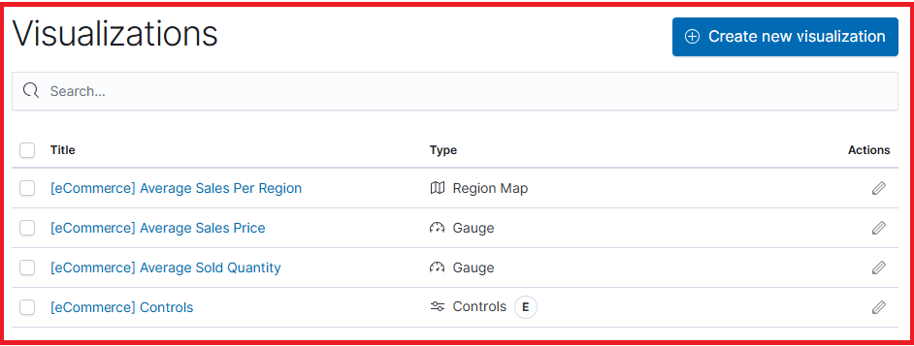
STEP 6:VISUALIZATIONS IN KIBANA
Click on the visualize in the left side bar of Kibana and the following image is shown below.

Slide 37
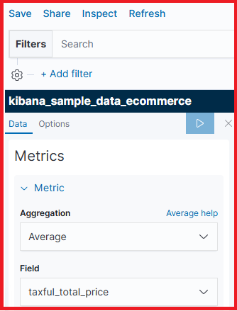
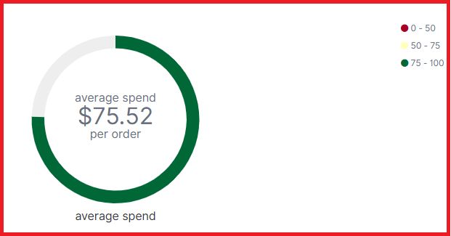
Click on the [eCommerce] Average Sales Price visualization and the following image is shown below.

Slide 38
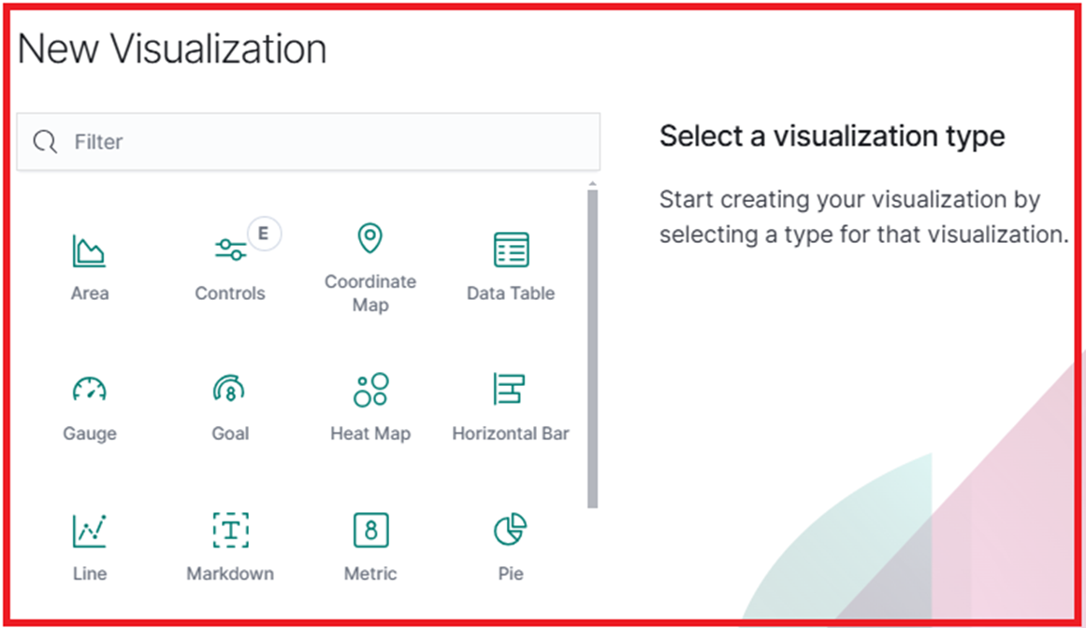
STEP 7:HOW TO CREATE VISUALIZATION IN KIBANA
Open the visualization editor, then make sure the correct fields appear.
1.On the dashboard, click Create visualization.
2.Make sure the Kibana Sample Data eCommerce data view appears, then set the time filter to Last 30 days.

Slide 39
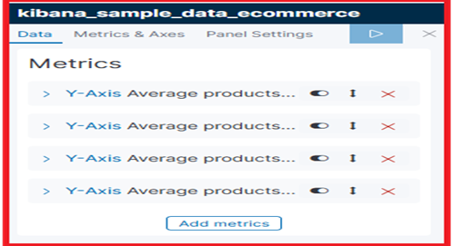
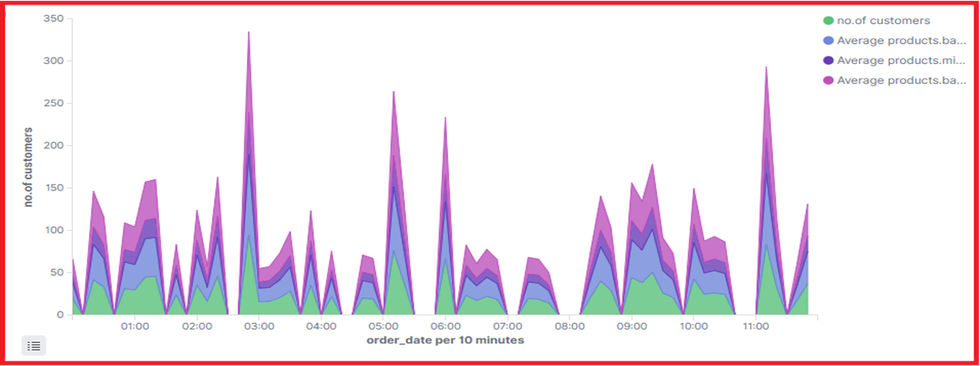
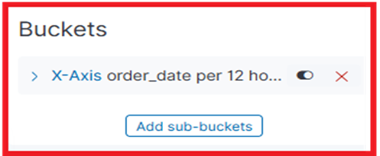
Select a visualize type and I created multilayer visualization area chart for no.of customers, average product.price,average base.price,average product.min price. v/s order date per 10 minutes and apply changes and save as new visualization 1. The following images are shown below.

Slide 40
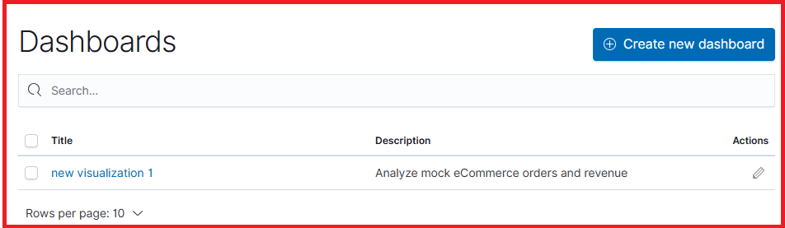
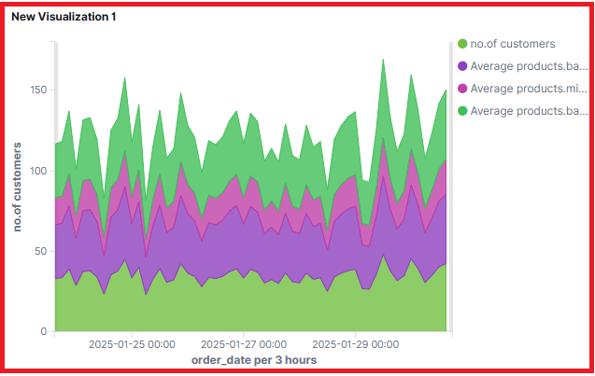
STEP 8:HOW TO CREATE DASHBOARD IN KIBANA
Add the sample eCommerce data, and create and set up the dashboard.
1. Install the eCommerce sample data set.
2.Go to Dashboards.
3.On the Dashboards page, click Create dashboard.
Once visualization is created and save and add it on to the dashboard.
The following images are the added visualization in the dashboard are shown below.

Slide 41


